Slide 1
JavaScript Arrays
Mirzoulugbek Yusupov

Slide 2
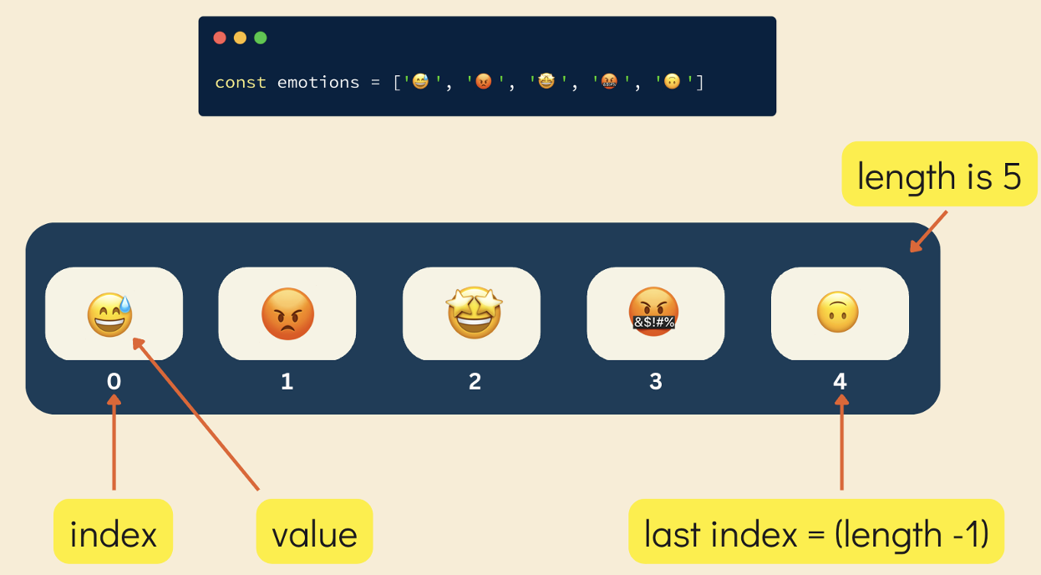
Introduction to Arrays
An Array is an ordered collection of elements that are used to store multiple values in a single variable.
Arrays in JavaScript are zero-indexed and can hold multiple data types
Types of Arrays
1D Arrays (Basic lists of values)
2D Arrays (Arrays inside arrays)
Array Properties
Length Property
Indexing & Accessing Elements

Slide 3
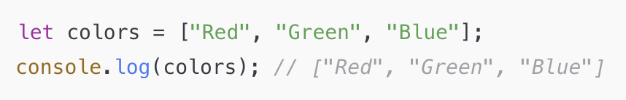
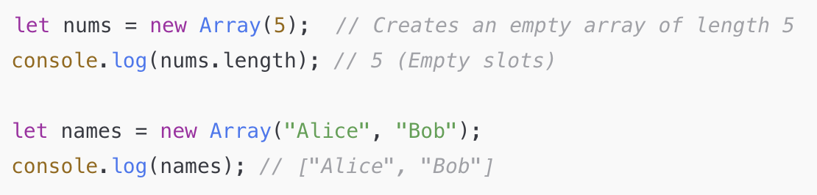
Ways to Create an Arrays
Using Array Literals
Uses [] brackets.
2. Using new Array() Constructor
Creates an array with elements OR an empty array with a fixed size.

Slide 4
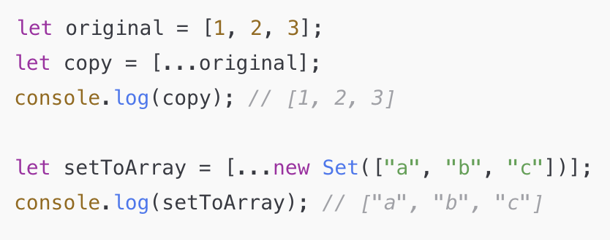
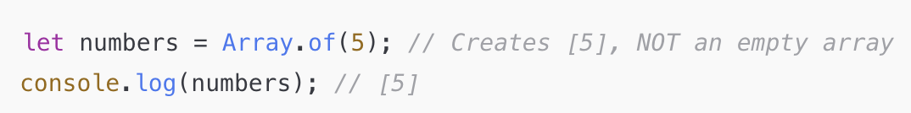
Ways to Create an Arrays
3. Using Spread Operator (...)
Expands elements into an array.
Useful for copying arrays and converting iterables.
4. Using Array.of()
Creates an array from given values.
Unlike new Array(), it does not treat a number as a length.

Slide 5
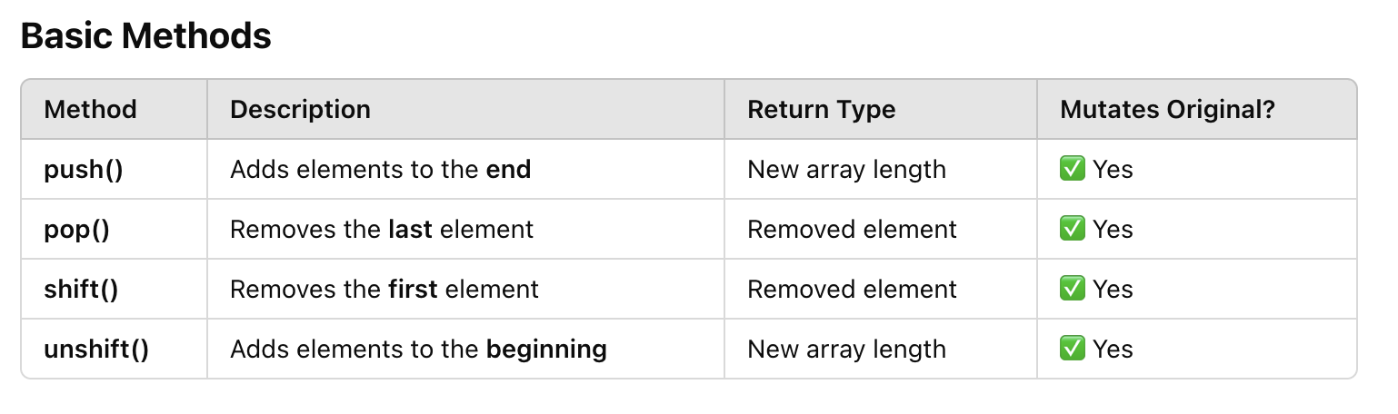
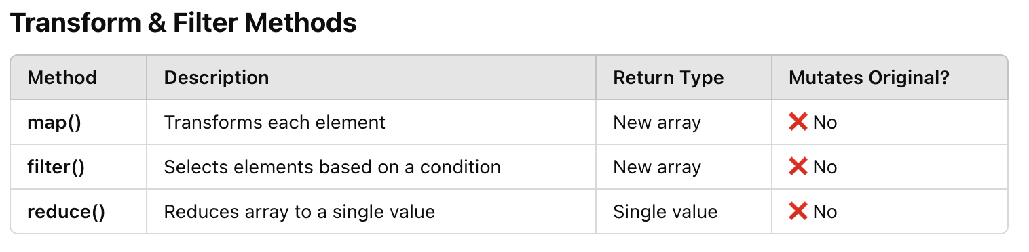
JavaScript Array Methods

Slide 6
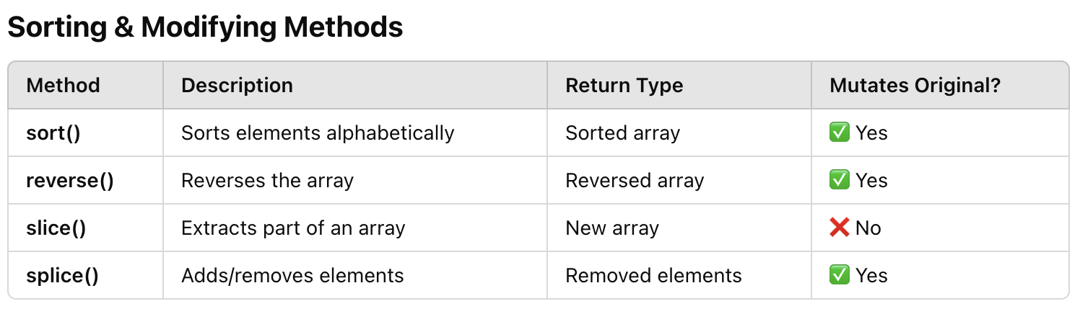
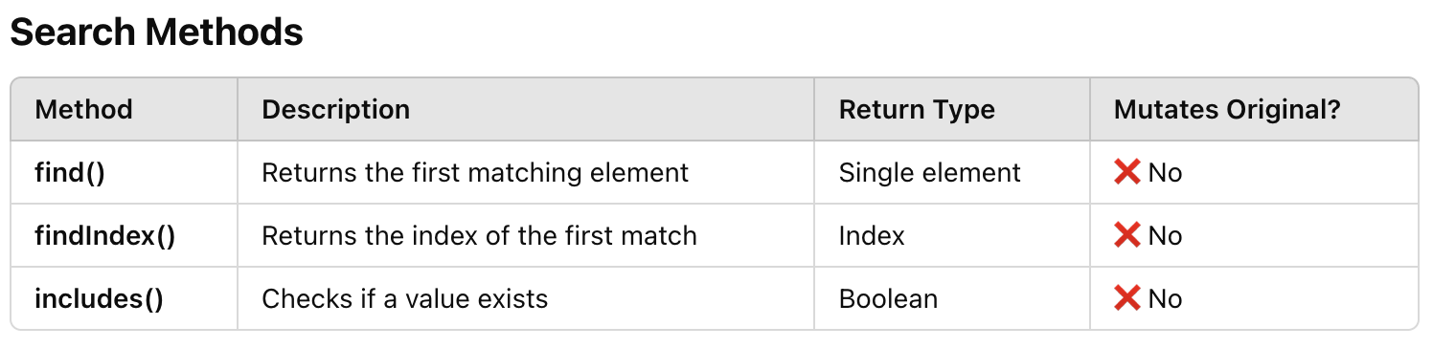
JavaScript Array Methods

Slide 7
Practice
Challenge 1 - Write a JavaScript function to get the first elements of an array. Passing the parameter “n” will return the first “n” elements of the array.
console.log(first([7, 9, 0, -2])); ->7
console.log(first([],3)); -> []
console.log(first([7, 9, 0, -2],3)); -> [7,9,0]
console.log(first([7, 9, 0, -2],6)); -> [7,9,0,-2]
console.log(first([7, 9, 0, -2],-3)); -> -3
Challenge 2 - Write a JavaScript function to get the last elements of an array. Passing the parameter “n” will return the last “n” elements of the array.
console.log(last([7, 9, 0, -2])); -> -2
console.log(last([7, 9, 0, -2],3)); -> [9,0,-2]
console.log(last([7, 9, 0, -2],6)); -> [7,9,0,-2]
Challenge 3 - Write a simple JavaScript program to join all elements of the following array into a string.
myColor = ["Red", "Green", "White", "Black"]; - > "Red,Green,White,Black"

Slide 8
Practice
Challenge 4 -Write a JavaScript program that accepts a number as input and inserts dashes (-) between each number.
For example: 025468 the output should be 0-2-5-4-6-8.
Challenge 5 - Write a JavaScript program to sort the items of an array.
Sample array : var arr1 = [ -3, 8, 7, 6, 5, -4, 3, 2, 1 ];
Sample Output : -4,-3,1,2,3,5,6,7,8
Challenge 6 - Write a JavaScript program to find the most frequent item in an array.
Sample array : var arr1=[3, 'a', 'a', 'a', 2, 3, 'a', 3, 'a', 2, 4, 9, 3];
Sample Output : a ( 5 times )
Challenge 7 - Write a JavaScript program that accepts a string as input and swaps the case of each character.
For example if you input 'The Quick Brown Fox' the output should be 'tHE qUICK bROWN fOX'.

Slide 9
Practice
Challenge 8 - We have the following arrays :
color = ["Blue ", "Green", "Red", "Orange", "Violet", "Indigo", "Yellow "];
o = ["th","st","nd","rd"]
Write a JavaScript program to display the colors in the following way :
"1st choice is Blue .”
"2nd choice is Green.”
"3rd choice is Red.”
Note : Use ordinal numbers to tell their position.
Challenge 9 - There are two arrays with individual values. Write a JavaScript program to compute the sum of each individual index value in the given array.
array1 = [1,0,2,3,4]; array2 = [3,5,6,7,8,13];
Expected Output : [4, 5, 8, 10, 12, 13]

Slide 10
Thank You

